Slide 1
Overview of SAS/GRAPH
Statistics 6740
Lecture 27

Slide 2
Lecture Outline
Questions
SAS’s description of SAS/GRAPH
Examples
Procedures
Basic
Additional/Global Statements
Associated global statements
Upcoming schedule
Daily assignment

Slide 3
SAS Description (User’s Guide)
SAS/GRAPH is the data visualization and presentation (graphics) component of the SAS System. As such, SAS/GRAPH does the following:
organizes the presentation of your data and visually represents the relationship between data values as two- and three-dimensional graphs, including charts, plots, and maps;
enhances the appearance of your output by allowing you to select text fonts, colors, patterns, and line styles, and control the size and position of many graphics elements;
creates presentation graphics. SAS/GRAPH can create text slides, display several graphs at one time, combine graphs and text in one display, and create automated presentations;
generates a variety of graphics output that you can display on your screen or in a Web browser, store in catalogs, or review. You can send the graphics output to a hard copy graphics output device such as a laser printer, plotter, or slide camera; and
provides utility procedures and statements to manage the output.

Slide 4
Features (SAS Products & Solutions)
Data analysis
Data visualization with maps, charts and plots
Visualization presentation
Visualization delivery
Geocoding

Slide 5
Examples – Choropleth Map

Slide 6
Examples - 3D Scatterplot

Slide 7
Examples - Scatterplot

Slide 8
Examples – Bar Chart

Slide 9
Basic SAS/GRAPH Procedure
G3D, G3GRID – 3D scatterplots and surface plots
GCHART – bar charts, pie charts, etc.
GCONTOUR – contour plots
GPLOT – scatterplots
GMAP – maps
BOXPLOT – boxplots
SGPLOT – combination plots

Slide 10
Additional SAS/GRAPH Procedures
Other Graphics Procedures:
GAREABAR – area bar chart displaying 2 statistics
GBARLINE – bar-line charts (overlay of bar chart and line plot)
GKPI – key performance indicator charts
GRADAR – radar, wind-rose, calendar charts
GSLIDE – slides
GTILE – rectangular tree maps
TREE – tree diagram
Other Related Procedures:
GANNO – displays graphs created by annotate datasets
GEOCODE, GINSIDE – analyses with geographic coordinates (find, compare)
GFONT – creates SAS/GRAPH fonts
GPROJECT – projects map data
MAPIMPORT – imports mapping data (ESRI shape files)
GREDUCE – reduces map complexity
GREPLAY – displays and manages graphics catalog

Slide 11
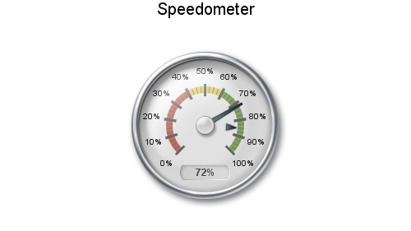
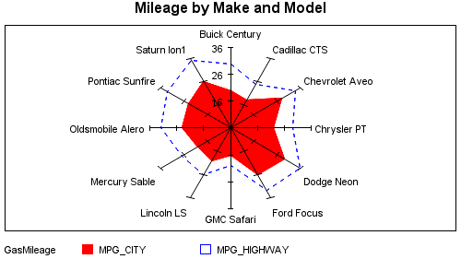
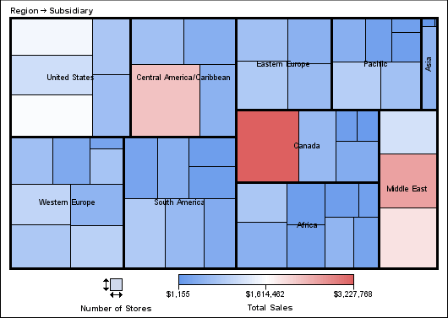
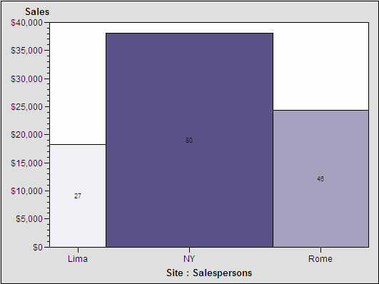
Examples – Other Charts

Slide 12
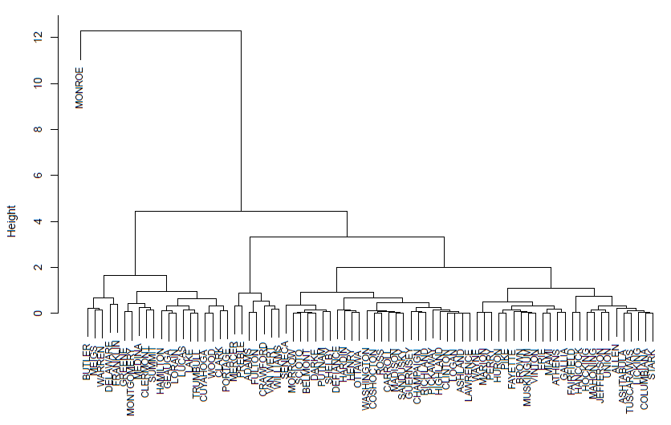
Examples - Dendogram

Slide 13
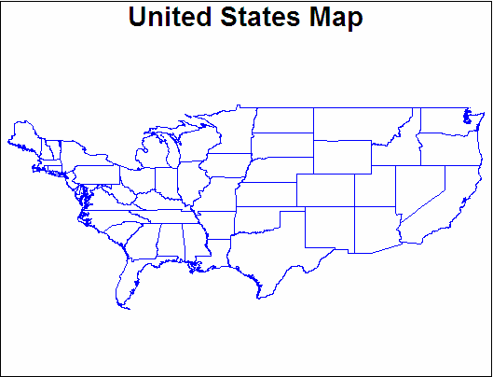
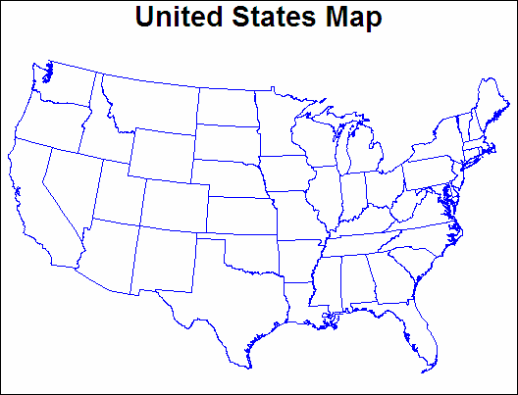
Illustration - GPROJECT
Projected
Unprojected

Slide 14
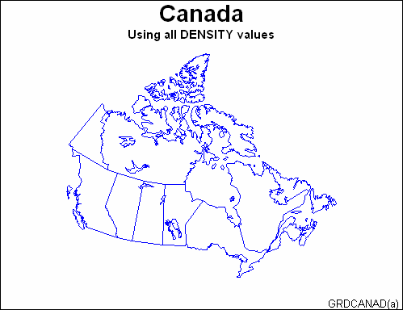
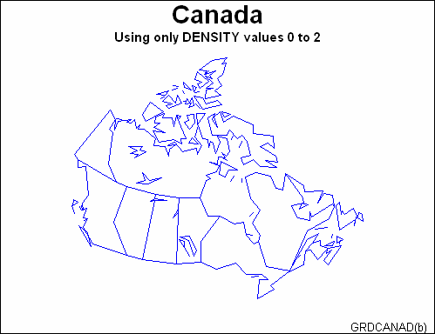
Illustration - GREDUCE

Slide 15
Associated Global Statements
TITLE, FOOTNOTE (internal, external)
BY, WHERE (internal)
GOPTIONS (external)
AXIS (external)
SYMBOL (external)
PATTERN (external)
LEGEND (external)

Slide 16
Upcoming Schedule
11/2 – GOPTIONS
11/4 – AXIS, SYMBOL, PATTERN, LEGEND
11/6 – GPLOT
11/9 – GCHART
11/13 – G3D, GCONTOUR
11/16 – SGPLOT
11/18 – Survey of other SAS/GRAPH procedures
11/20 – HW 5 due

Slide 17
Daily Assignment
Examine SAS/GRAPH documentation on GOPTIONS

